Slide 1

Chance-Constrained Stochastic Trajectory Optimization for Spacecraft in Nonlinear Dynamical Systems
Naoya Kumagai, Kenshiro Oguri
School of Aeronautics and Astronautics, Purdue University
December 9, 2025
Workshop on Stochastic Planning & Control of Dynamical Systems
64th IEEE Conference on Decision and Control

Slide 2
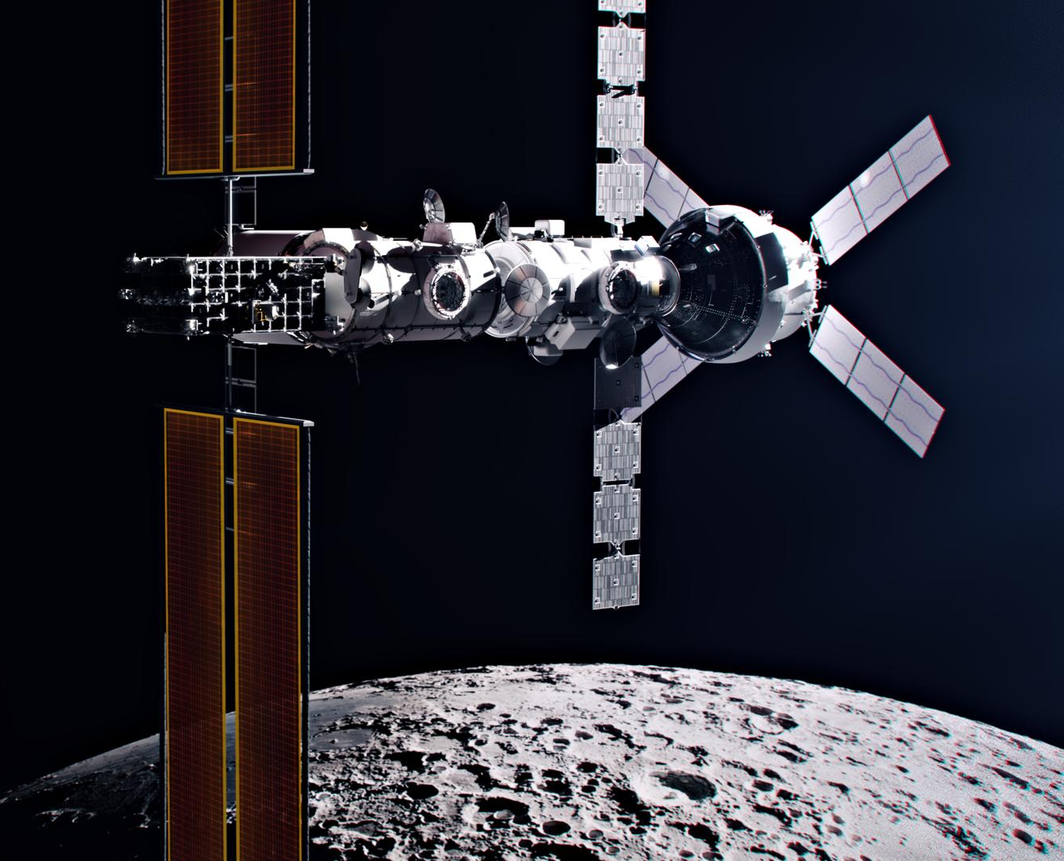
Motivation: Cislunar Space Exploration
Cislunar space (region near the Moon):
Increasing interest for NASA and industry partners
Potential ice on lunar south pole
Dynamical structures that can be leveraged for interplanetary spaceflight
Challenges of cislunar space
Quick dynamics --- state evolves quickly and real-time intervention is difficult
Frequent lunar flybys --- highly nonlinear region makes uncertainty quantification difficult
How can we adapt mission design practices sustainably to reliably explore the cislunar region?

Slide 3
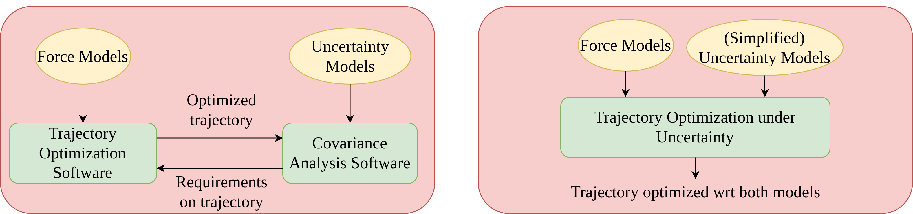
Mission Design Practice: Current vs Proposed
Traditional:
Iterative: trajectory optimization <-> uncertainty analysis
Heuristic safety/fuel margins
Time-consuming
Stochastic Optimal Control Approach:
Unified optimization
Probabilistic guarantees based on rigorous theory

Slide 4
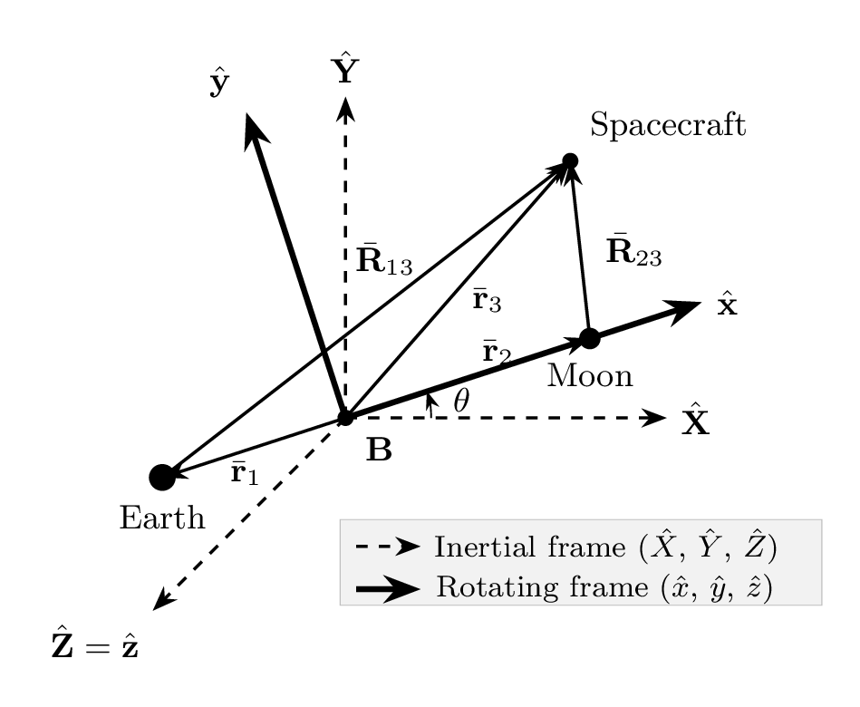

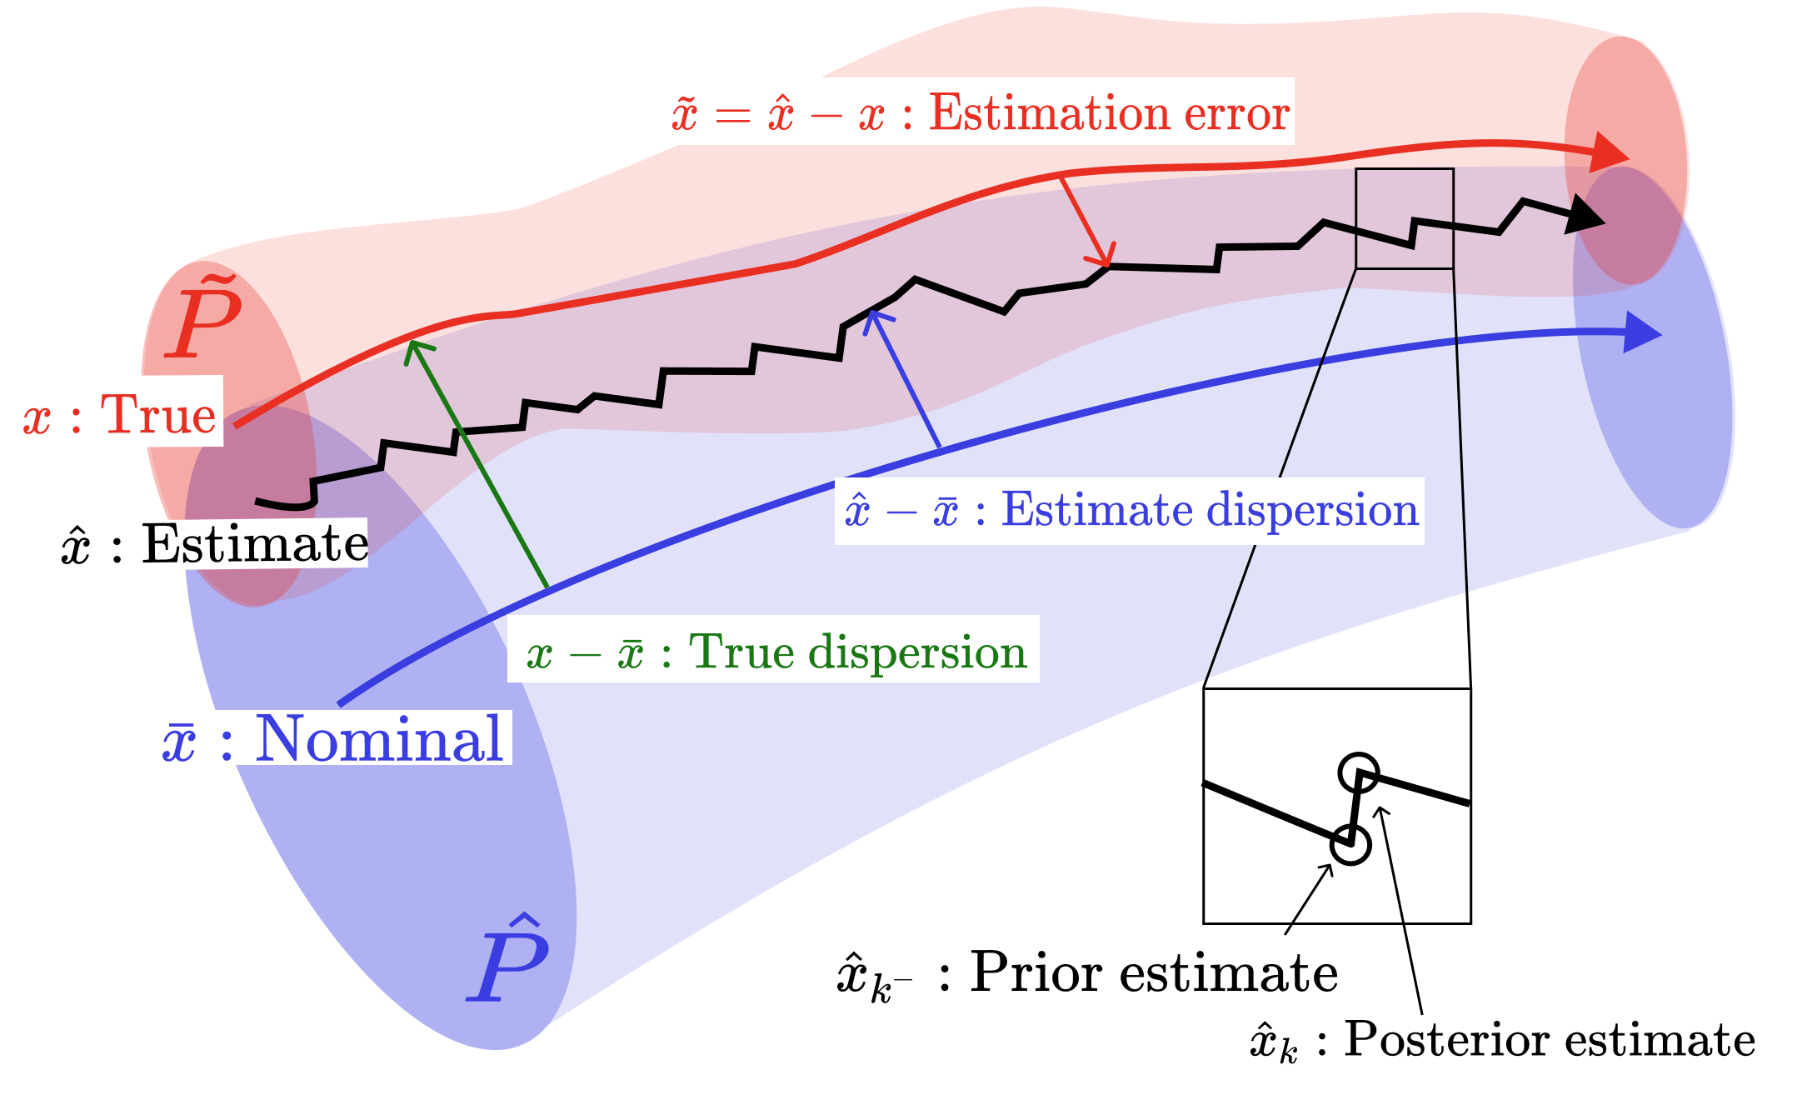
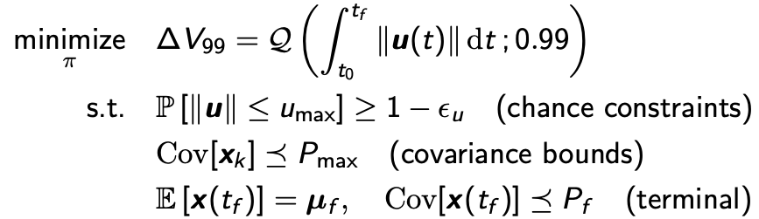
Problem Formulation
Dynamics: Circular-Restricted Three-Body Problem (CR3BP)[1]
Earth-Moon system in rotating frame
Continuous (low)-thrust spacecraft
Uncertainty Models:
Stochastic acceleration
Maneuver execution errors: control-dependent noise
Kalman filter: navigation errors
[1] Pavlak, T., “Trajectory Design and Orbit Maintenance Strategies in Multi-Body Dynamical Regimes,” Ph.D. Thesis, Purdue Univ., West Lafayette, IN, 2013.

Slide 5

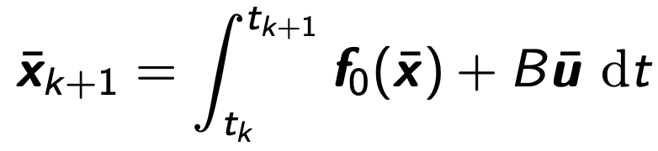
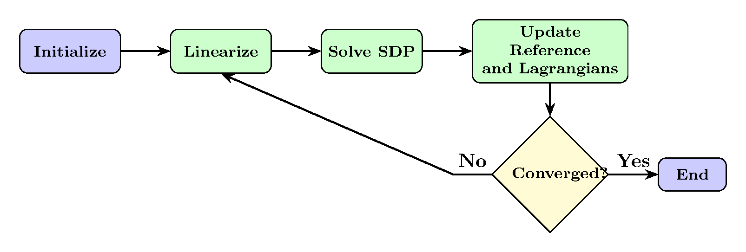
Tools: Covariance Steering and SCP
Linear Feedback Policy:
Nominal + trajectory correction
Quick computation of trajectory correction
Covariance Propagation (EKF-like):
Mean: nonlinear dynamics
Covariance: closed-loop propagation based on linearized dynamics around mean
Convexification of Covariance Steering [2]:
Linear closed-loop covariance dynamics can be convexified
Formulate as an SDP
Sequential Convex Programming (SCP) [3]:
Linearize the mean + covariance dynamics
Ensure nonlinear mean dynamics obeyed at convergence
Trust region and Lagrangian updates
[2] Liu, F., Rapakoulias, G., and Tsiotras, P., “Optimal Covariance Steering for Discrete-Time Linear Stochastic Systems,” IEEE Transactions on Automatic Control, 2025.
[3] Oguri, K., “Successive Convexification with Feasibility Guarantee via Augmented Lagrangian for Non-Convex Optimal Control Problems,” 62nd IEEE CDC, 2023.

Slide 6
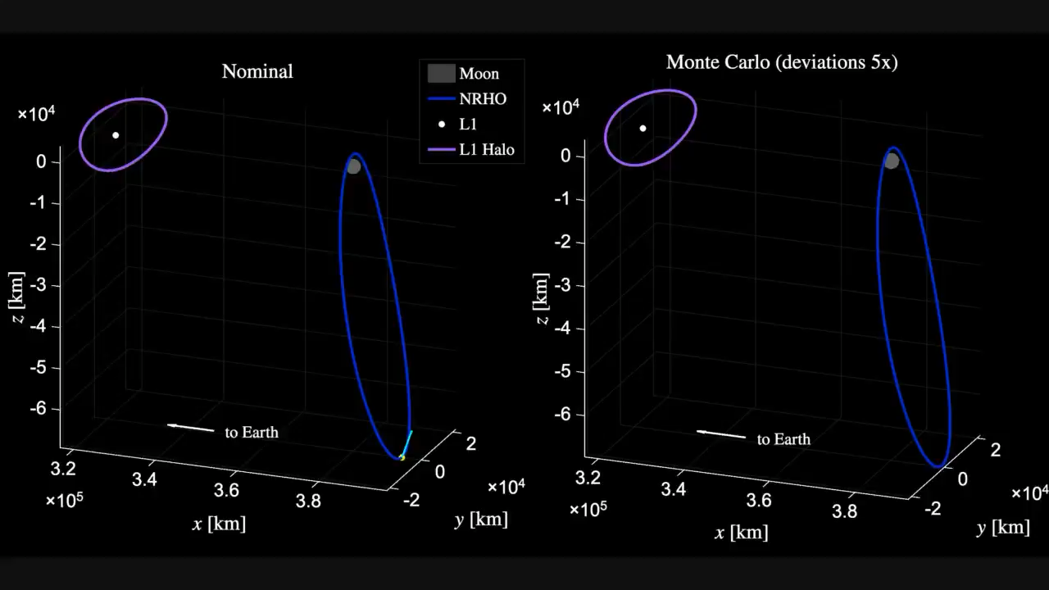
Simulation
Notes:
Transfer between periodic solutions in the CR3BP. Very far from the Earth.
Depart from the southernmost part of the NRHO.
On the left, nominal trajectory along with a vector for the thrust direction.
On the right, closed-loop Monte Carlo simulations with deviations enlarged for visualization.
Immediately, we perform a gravity assist to change the inclination of our orbit.

Slide 7


SCvx* algorithm on GitHub
This presentation is based on our paper “Robust Cislunar Low-Thrust Trajectory Optimization Under Uncertainties via Sequential Covariance Steering” in the Journal of Guidance, Control, and Dynamics, 2025.
This work was supported by the U.S. Air Force Office of Scientific Research through research grant FA9550-23-1-0512.
Paper

